Slide 1
Introduction to Programming
Session 07
Functions in Java

Slide 2
Objectives
Top-Down Design
What is a function?
Functions in Java
Types of Java functions
Standard Library functions
User-defined Method
Overloading
The scope of the variable in java

Slide 3
Top-Down Design
A top-down approach (also known as stepwise design) is essentially the breaking down of a system to gain insight into the sub-system that make it up.
A top-down approach an overview of the system is formulated specifying but not detailing any first-level subsystems.
Each subsystems is then refined in yet greater detail, sometimes in many additional subsystems levels, until the entire specification is reduced to base elements.
Once these base elements are recognized then we can build these as computer modules.
Once they are built we put them together, making the entire system from these individual components.

Slide 4
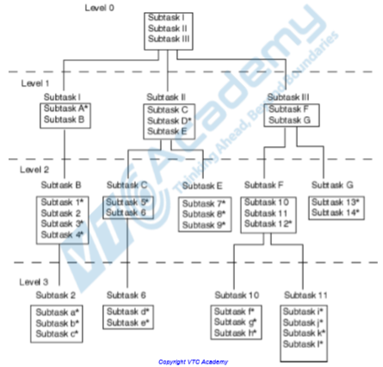
Top-Down Design

Slide 5
What is a function?
In mathematics, you might have studied about functions. For example, f(x) = x² is a function that returns squared value of x.
  If x = 2, then f(2) = 4
  If x = 3, f(3) = 9
  ….
Similarly, in programming, a function is a block of code that performs a specific task.
In object-oriented programming, method is a jargon used for function. Methods are bound to a class and they define the behavior of a class.

Slide 6
Functions in Java
A function is a block of code which only runs when it is called.
You can pass data, known as parameters, into a method.
Functions are used to perform certain actions, and they are also known as functions.
The advantages of using functions?
  The main advantage is code reusability. You can write a functiononce, and use it multiple times. You do not have to rewrite the entire code each time. Think of it as, "write once, reuse multiple times."
  Functions make code more readable and easier to debug. For example, getSalaryInformation() method is so readable, that we can know what this method will be doing than actually reading the lines of code that make this method.

Slide 7
Types of Java functions
Depending on whether a function is defined by the user, or available in standard library, there are two types of functions:
  Standard Library Methods
  User-defined Methods

Slide 8
Standard Library Functions
The standard library functions are built-in s in Java that are readily available for use. These standard libraries come along with the Java Class Library (JCL) in a Java archive (*.jar) file with JVM and JRE.
For example:
  print() is a function used to print the string inside quotation marks.
  sqrt() is a of Math class. It returns square root of a number.
Example:
  public class Numbers {
  public static void main(String[] args) {
  System.out.print("Square root of 4 is: " + Math.sqrt(4));
  }
  }
Output:
Square root of 4 is: 2.0

Slide 9
User-defined Function
You can also define functions inside a class as per your wish
The complete syntax for defining a Java function is:
  modifier static returnType nameOffunction (Parameter List){
  // function body
  }
  modifier - defines access type whether the function is public, private and so on.
  static - If you use static keyword in a function then it becomes a static function. Static functions can be called without creating an instance of a class.
  returnType - A function can return a value. It can return native data types (int, float, double,...), native objects (String, Map, List etc.), or any other built-in and user defined objects. If the function does not return a value, its return type is void.
  nameOffunction - The name of the function is an identifier. You can give any name to a function. However, it is more conventional to name it after the tasks it performs. For example, calculateInterest, calculateArea, and so on.
  Parameters (arguments) - Parameters are the values passed to a function. You can pass any number of arguments to a function.
  function body - It defines what the function actually does, how the parameters are manipulated with programming statements and what values are returned. The codes inside curly braces { } is the body of the function.

Slide 10
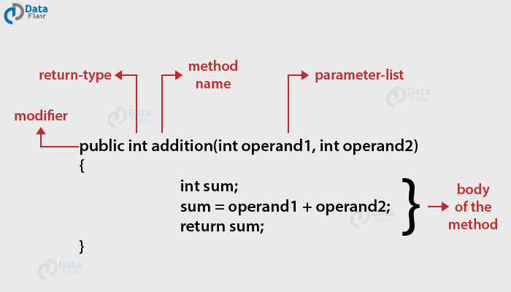
User-defined Function

Slide 11
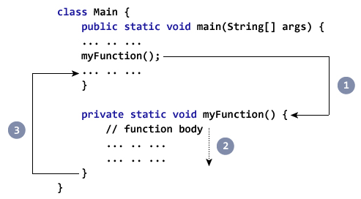
How to call a Java function
Now you defined a function, you need to use it. For that, you have to call the function. Here's how: myFuntion();
While Java is executing the program code,
it encounters myFunction(); in the code.
The execution then branches to the
myFunction() method, and
executes code inside the body
of the function.
After the codes execution inside
The function body is completed,
the program returns to the original
state and executes the next statement.

Slide 12
Example
class Main {
public static void main(String[] args) {
System.out.println("About to encounter a function.");
// function call
myFunction();
System.out.println("Function was executed successfully!");
}
// method definition
static void myFunction(){
System.out.println("Inside myFunction()!");
}
}
Output:
About to encounter a function.
Inside myFunction()!
Function was executed successfully!

Slide 13
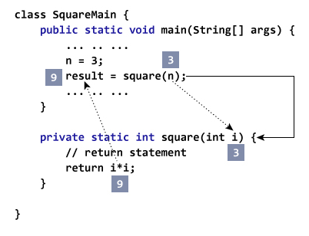
Example
public class SquareMain {
public static void main(String[] args) {
int result, n;
n = 3
result = square(n);
System.out.println("Square of 3 is: " + result);
n = 4
result = square(n);
System.out.println("Square of 4 is: " + result);
}
private static int square(int i) {
return i * i;
}
}
Output:
Squared value of 3 is: 9
Squared value of 4 is: 16

Slide 14
Example
public class ArithematicMain {
public static int getIntegerSum (int i, int j) {
return i + j;
}
public static int multiplyInteger (int x, int y) {
return x * y;
}
public static void main(String[] args) {
System.out.println("10 + 20 = " + getIntegerSum(10, 20));
System.out.println("20 x 40 = " + multiplyInteger(20, 40));
}
}
Output:
10 + 20 = 30
20 x 40 = 800

Slide 15
Example
public class JFunctions {
// method defined
private static int getSquare(int x){
return x * x;
}
public static void main(String[] args) {
for (int i = 1; i <= 5; i++) {
// method call
result = getSquare(i)
System.out.println("Square of " + i + " is : " + result); }
}
}
Output:
Square of 1 is : 1
Square of 2 is : 4
Square of 3 is : 9
Square of 4 is : 16
Square of 5 is : 25

Slide 16
Overloading
When a class has two or more functions by the same name but different parameters, it is known as function overloading. It is different from overriding. In overriding, a function has the same function name, type, number of parameters, etc.
Let’s consider the example discussed earlier for finding minimum numbers of integer type. If, let’s say we want to find the minimum number of double type. Then the concept of overloading will be introduced to create two or more functions with the same name but different parameters.

Slide 17
Overloading
public class ExampleOverloading {
public static void main(String[] args) {
int a = 11, b = 6;
double c = 7.3, d = 9.4;
int result1 = minFunction(a, b);
double result2 = minFunction(c, d);
System.out.println("Minimum Value = " + result1);
System.out.println("Minimum Value = " + result2);
}
public static int minFunction(int n1, int n2) {// for integer
int min=n2;
if (n1 > n2)
min = n2;
return min;
}
public static double minFunction(double n1, double n2) {// for double
double min=n2;
if (n1 > n2)
min = n2;
return min;
}
}
Output:
Minimum Value = 6
Minimum Value = 7.3

Slide 18
The scope of the variable in java
In java, variable is the name of the computer memory.
There are 3 types of variables in java, including
  Local variables (local)
  Global variables (instance)
  Static variables (static).

Slide 19
Local variables
Local variables are declared in functions, constructor functions, or in blocks.
Local variables are created inside functions, constructors, and blocks and will be destroyed at the end of functions, constructors and blocks.
Do not use "access modifier" when declaring local variables.
Local variables are stored on the memory stack.
You need to initialize the default value for the local variable before you can use it.

Slide 20
Local variables
public class LocalVariable {
static void printValue() {
int n = 10; // local variable
System.out.println(" value of n: " + n);
}
public static void main(String[] args) {
printValue();
}
}
Output:
Value of n: 10

Slide 21
Local variables
public class LocalVariable1 {
static void printValue() {
int n; // local variable
System.out.println(" value of n: " + n);
}
public static void main(String[] args) {
printValue();
}
}
Output:
Exception in thread "main" java.lang.Error: Unresolved compilation problem: The local variable n may not have been initialized

Slide 22
Global variables
Instance variables are declared in a class, outside of functions, constructors, and blocks.
Instance variables are stored in heap memory.
Instance variables are created when an object is created using the keyword "new" and will be destroyed when the object is destroyed.
Instance variables can be used by functions, constructors, blocks,…. But it must be used through a specific object.
You are allowed to use "access modifier" when declaring instance variables, the default is "default".
The instance variable has a default value depending on its data type. For example, if the int type, short, byte, the default value is 0, the double type is 0.0d, ... So you will not need to initialize the value of the instance variable before using.
Inside the class where you declare instance variables, you can call it directly by name when used everywhere inside that class.

Slide 23
Global variables
public class Sinhvien {
public String ten; // biến instance "ten" kiểu String, có giá trị mặc định là null
private int tuoi; // biến instance "tuoi" kiểu Integer, có giá trị mặc định là 0
public Sinhvien(String ten) {// sử dụng biến ten trong một constructor
this.ten = ten;
}
public void setTuoi(int tuoi) {// sử dụng biến tuoi trong phương thức setTuoi
this.tuoi = tuoi;
}
public void showStudent() {
System.out.println("Ten : " + ten);
System.out.println("Tuoi : " + tuoi);
}
public static void main(String args[]) {
Sinhvien sv = new Sinhvien("Nguyen Van A");
sv.setTuoi(21);
sv.showStudent();
}
}
Output:
Ten : Nguyen Van A
Tuoi : 21

Slide 24
Static variables
Static variables are declared in a class with the keyword "static", outside of functions, constructors and blocks.
Static variables are stored in separate static memory.
Static variables are created when the program starts running and only destroyed when the program stops.
The default value of the static variable depends on the data type you declare is similar to the instance variable.
The static variable is accessed via the name of the class that contains it, with the syntax: ClassName.VariableName.
In a class, methods use a static variable by calling its name when that method is also declared with the keyword "static".

Slide 25
Static variables
public class Sinhvien {
// static variable 'ten'
public static String ten = "Nguyen Van A";
// static variable 'tuoi'
public static int tuoi = 21;
public static void main(String args[]) {
// call directory
System.out.println("Ten : " + ten);
// call by using class name
System.out.println("Ten : " + Sinhvien.tuoi);
}
}
Output:
Ten : Nguyen Van A
Tuoi : 21

Slide 26
Example
public class VariableTutorial {
// static variable
static int So = 10;
// global variable
String globalVariable= "Global variable";
int number1 = 10;
public void testVarial() {
// local variable
int number2 = 20;
}
public static void main(String[] args) {
// local variable
String localVariable = "local variable";
}
}

Slide 27
References
https://www.programiz.com/java-programming/methods
https://www.tutorialspoint.com/java/java_methods.htm
https://data-flair.training/blogs/java-method/
http://mrbool.com/functions-in-java-introduction-and-practical-examples/22194
https://www.geeksforgeeks.org/function-interface-in-java-with-examples/
https://www.w3schools.com/java/java_methods.asp
https://www.geeksforgeeks.org/variable-scope-in-java/
http://ecomputernotes.com/java/data-type-variable-and-array/scope-of-a-variable
https://gpcoder.com/1790-bien-trong-java/

Slide 28


